Slide 1

No User Necessary: Creating a Client Troubleshooting Tool
Adam Bertram
Microsoft Cloud/Datacenter Management MVP,
Adam the Automator, LLC
Based on the upcoming Pluralsight Course Building a Client Troubleshooting Tool

Slide 2
Helpdesk Workflow. Ouch!
Lots of windows; One purpose.
Notes:
This slide will include screenshots of all different open windows like the services MMC, installed updates PowerShell console, event log window, etc

Slide 3

A Day In The Life Of…
Notes:
This is going to be a slide that introduces a skit I'll be putting on. I will be bringing up someone from the audience and they will be posing as a helpdesk employee.
It would be nice if you could do something that shows a system adminstrator talking to a helpdesk employee.

Slide 4










What We’ve Learned
Your "problem" is not “their” problem
Consider the audience
Look for pain points
Ask lots of questions
YOU don’t know what the best solution is

Slide 5



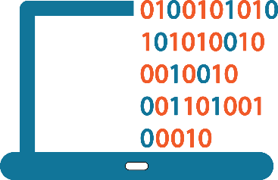
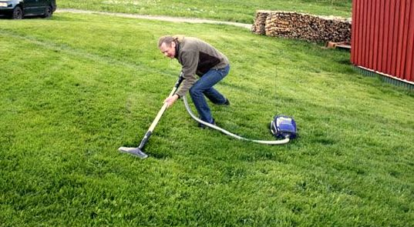


Building Tools for Others
Planning
Writing Code
Getting Feedback
Testing Code
Notes:
It would be neat if you could find an image or do something that shows someone handing someone else some kind of tool that makes no sense for what the other person is doing. Something like handing a power drill to someone building a ramshackle hut.
Some kind of dichotomy that would be humorous.

Slide 6
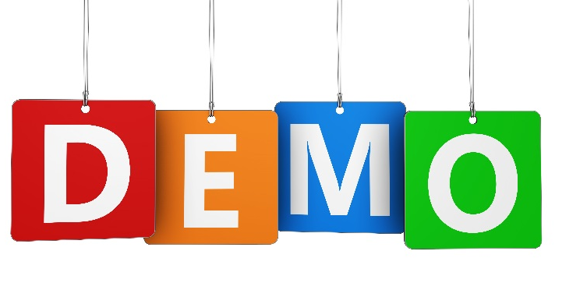

Tool Overview
What we'll be building
How it looks
What it can do
Notes:
This will be a slide introducing the upcoming demo. I'd like all demo intro slides to have the same kind of scheme.

Slide 7


Prerequisites and Assumptions
You're building a tool for someone less PowerShell-savvy
PowerShell v4
PowerShell Studio (optional but recommended)
File share
PowerShell remoting enabled on clients
Understand the concept of a "tool“
Comfortable with writing intermediate-level scripts
Technical Prerequisites
Knowledge Prerequisites

Slide 8

Building CLI Tools
Build code with no intention of a GUI
Console-only output is fine
Consider the GUI phase 2
Notes:
This is about coding a script with no intention of ever making it into a GUI.

Slide 9
PowerShell Studio

Slide 10

GUIs Serve Different Markets
GUIs have better discoverability
Some people don't care about scripting
The right tool for the job

Slide 11

Stay Tuned for a New Pluralsight Course
Notes:
This should include the Pluralsight logo.

Slide 12



Your Takeaways
Use your scripting kung-fu for good
GUIs aren't bad
Actually talk to people
Notes:
First Bullet: This is about helping others by contributing your services and building tools that others can use.
Second Bullet: Some people inherently think GUIs are for sissies. This is to show them that not everyone is a scripting, command line junkie.
To some people, that's not their job and they don't care.
Third Bullet:
System admnistrators typically like doing their own thing. This is supposed to be humorous to make sysadmins actually get out of their cube and talk to other people to get their feedback and help them

Slide 13
Questions?

